Slide 1

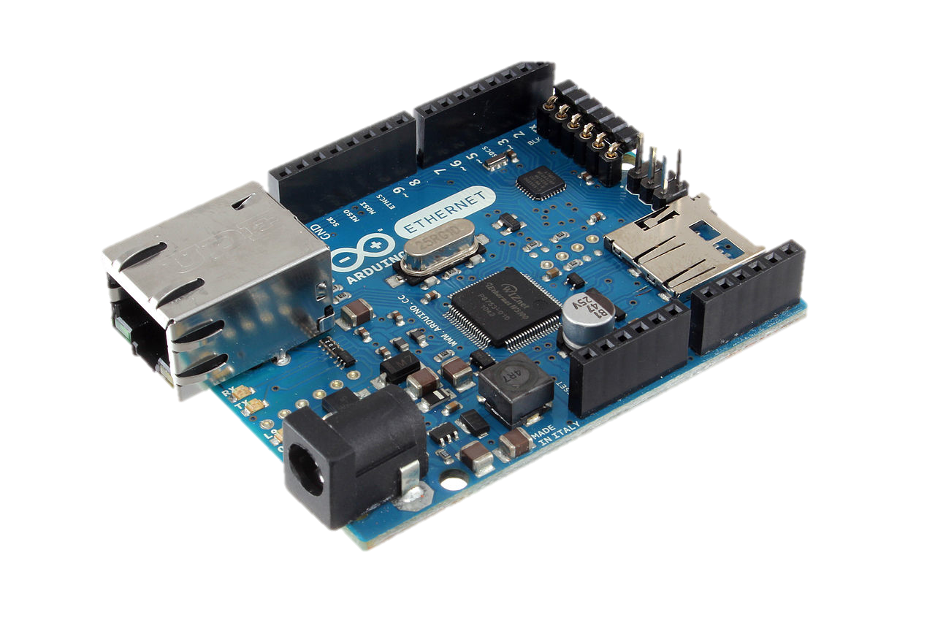
Web UI
Your Smart Device
Model Repository
PC6
PC3
Orchestration Service
PC5
DHCP
Physical Device GW
PC2
Advanced Reasoning Service
DS2OS GW
PC4
PC1

